Slide 1
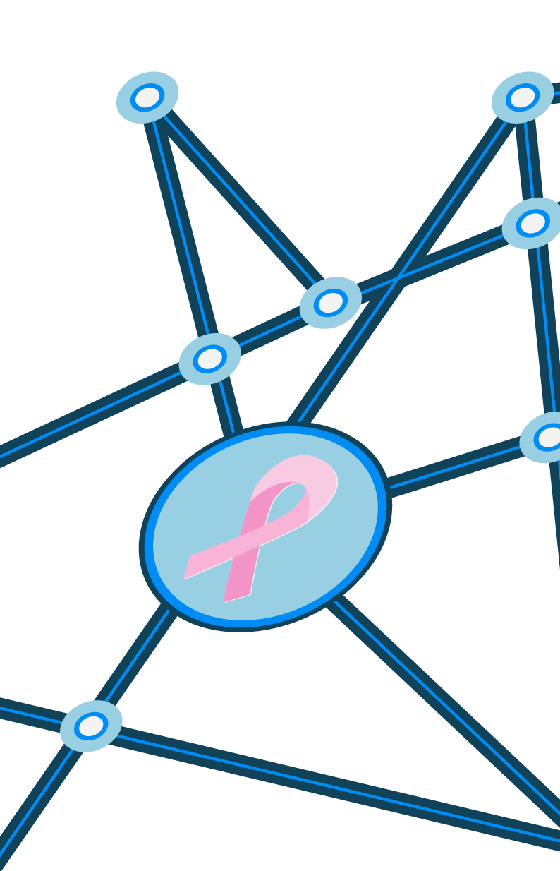

MACHINE LEARNING: BREAST CANCER CLASSIFICATION SUPPORT VECTOR MACHINES DR. RYAN AHMED
Cover #01

Slide 2
1. BUSINESS CASE
5 MINUTES

Slide 3



1. BUSINESS CASE
DESCRIPTION
Breast cancer is the most common cancer among women worldwide, accounting for 25% of all cancer cases and affected 2.1 Million people in 2015.
Early diagnosis significantly increases the chances of survival. A key challenge in cancer detection is how to classify tumors into (1) malignant or (2) benign.
Machine Learning (ML) dramatically improves the accuracy of diagnosis. Research indicates that most experienced physicians can diagnose cancer with 79.97% accuracy while 91.1% (higher) correct diagnosis is achieved using ML.
Breast Cancer Detection with Reduced Feature Set, in Computational and Mathematical Methods in Medicine Article ID 265138(1): 2014
Notes:
Tumors are classified as benign and malignant. Benign tumors are not cancerous or life threatening.
However these can increase the risk of getting breast cancer. Malignant tumors are cancerous and more alarming than benign tumors.
In order to improve accuracy of breast mass classification as benign and malignant, machine learning strategies are used.

Slide 4
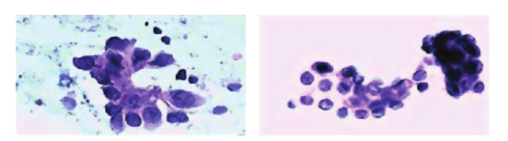
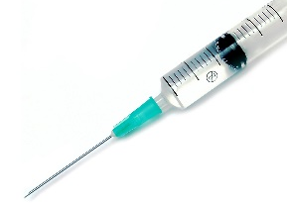

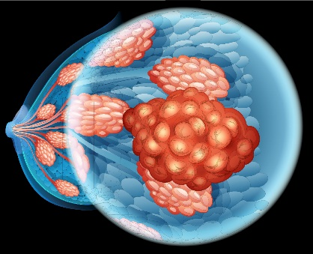

1. BUSINESS CASE
CANCER DIAGNOSIS PROCEDURE
TUMOR IMAGES
FEATURES
CLASSIFICATION
FINE NEEDLE ASPIRATE (FNA)
MALIGNANT
RADIUS
TEXTURE
PERIMETER
AREA
SMOOTHNESS
BENIGN
https://www.researchgate.net/publication/271907638_Breast_Cancer_Detection_with_Reduced_Feature_Set
https://plus.google.com/+Ehealthyblog
Notes:
Features have been computed from a digitized image of a fine needle aspirate (FNA) of a breast mass
Ten real-valued features are calculated for each cell nucleus, and the mean, standard error, and “worst” or largest of these features were calculated for each image, resulting in 30 features
Thus, there is a vital need for tools to rapidly evaluate breast masses and classify them as benign or malignant.
Ideally these tools would require few consumables and minimal training to make an assessment.

Slide 5
2. DESCRIBING THE PROBLEM USING THE
ML VOCABULARY
15 MINUTES

Slide 6
2. DATASET IN ML TERMS
DATASET IN MACHINE LEARNING TERMS
INPUT: 30 FEATURES
TARGET CLASS: 2
MALIGNANT
CLASSIFIER
RADIUS
TEXTURE
PERIMETER
AREA
SMOOTHNESS
BENIGN
Dataset:
Number of Instances: 569
Class Distribution: 212 Malignant, 357 Benign
Data source: https://archive.ics.uci.edu/ml/datasets/Breast+Cancer+Wisconsin+(Diagnostic)
https://www.researchgate.net/publication/271907638_Breast_Cancer_Detection_with_Reduced_Feature_Set

Slide 7
2. DATASET IN ML TERMS
SUPPORT VECTOR MACHINE CLASSIFIER
MAX MARGIN
HYPERPLANE
SUPPORT VECTORS
FEATURE #2
MAXIMUM MARGIN
FEATURE #1
Data source: https://archive.ics.uci.edu/ml/datasets/Breast+Cancer+Wisconsin+(Diagnostic)
https://www.researchgate.net/publication/271907638_Breast_Cancer_Detection_with_Reduced_Feature_Set
Notes:
Line is searched using maximum margin
Line separates the two points with maximum distance. These two points are the most critical in the SVM.

Slide 8


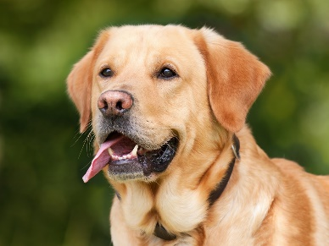
2. DATASET IN ML TERMS
SUPPORT VECTOR MACHINE CLASSIFIER
FEATURE #2
FEATURE #1
http://www.freakingnews.com/Cat-or-Dog-Pictures--1120-5.asp
https://www.pexels.com/photo/animal-pet-cute-kitten-45201/
Notes:
Line is searched using maximum margin
Line separates the two points with maximum distance. These two points are the most critical in the SVM.
Support vectors are very close to the boundaries. SVM looks are the most extreme points which are on the boundary.

Slide 9

3. VISUALIZATION OF
THE DATA
10 MINUTES

Slide 10

4. MODEL TRAINING (FINDING OUR SOLUTION)
20 MINUTES

Slide 11
5. EVALUATING OUR MODEL (SOLUTION)
20 MINUTES

Slide 12
5. EVALUATING THE MODEL
MODEL EVALUATION USING TESTING DATASET
TRAINED MODEL
(MAX MARGIN
HYPERPLANE)
FEATURE #2
TESTING DATASET
FEATURE #1
Data source: https://archive.ics.uci.edu/ml/datasets/Breast+Cancer+Wisconsin+(Diagnostic)
https://www.researchgate.net/publication/271907638_Breast_Cancer_Detection_with_Reduced_Feature_Set
Notes:
Line is searched using maximum margin
Line separates the two points with maximum distance. These two points are the most critical in the SVM.

Slide 13
5. EVALUATING THE MODEL
MODEL GENERALIZATION
GENERALIZED
MODEL
FEATURE #2
OVERFITTED
MODEL
FEATURE #1
Data source: https://archive.ics.uci.edu/ml/datasets/Breast+Cancer+Wisconsin+(Diagnostic)
https://www.researchgate.net/publication/271907638_Breast_Cancer_Detection_with_Reduced_Feature_Set
Notes:
Line is searched using maximum margin
Line separates the two points with maximum distance. These two points are the most critical in the SVM.

Slide 14
5. EVALUATING THE MODEL
CONFUSION MATRIX
TRUE CLASS
+
-
TYPE I ERROR
+
TRUE +
FALSE +
PREDICTIONS
-
FALSE -
TRUE -
TYPE II ERROR
Notes:
Line is searched using maximum margin
Line separates the two points with maximum distance. These two points are the most critical in the SVM.

Slide 15

6. IMPROVING OUR MODEL (SOLUTION)
10 MINUTES

Slide 16
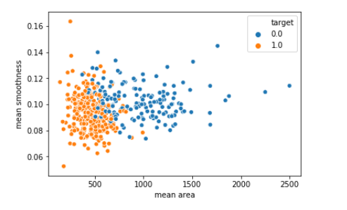
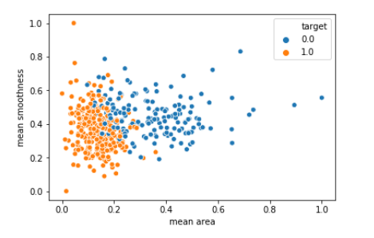
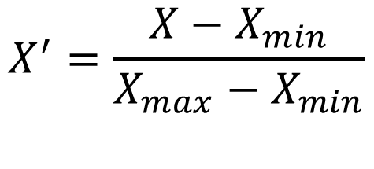
6. IMPROVING THE MODEL
DATA NORMALIZATION
WITHOUT NORMALIZATION
WITH NORMALIZATION
Feature scaling (Unity-based normalization) brings all values into range [0,1]
$$X^{′}=\frac{X−X_{min}}{X_{max}−X_{min}}$$
Notes:
Line is searched using maximum margin
Line separates the two points with maximum distance. These two points are the most critical in the SVM.

Slide 17
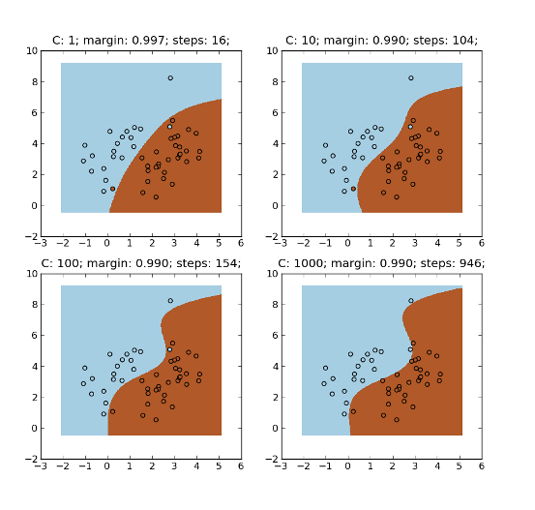
6. IMPROVING THE MODEL
SVM PARAMETERS OPTIMIZATION
C parameter: Controls trade-off between classifying training points correctly and having a smooth decision boundary
Small C (loose) makes cost (penalty) of misclassification low (soft margin)
Large C (strict) makes cost of misclassification high (hard margin), forcing the model to explain input data stricter and potentially over fit.
FEATURE #2
FEATURE #1
http://mlpy.sourceforge.net/docs/3.4/svm.html
Notes:
C and Gamma are the parameters for a nonlinear support vector machine (SVM) with a Gaussian radial basis function kernel.
The goal is to find the balance between "not too strict" and "not too loose".
Therefore, often times it is desirable to specifically allow some training points to be misclassified in order to have an "overall better" position of the separating hyperplane.

Slide 18


6. IMPROVING THE MODEL
SVM PARAMETERS OPTIMIZATION
Gamma parameter: controls how far the influence of a single training set reaches
Large gamma: close reach (closer data points have high weight)
Small gamma: far reach (more generalized solution)
s$mall γ$
Large $γ$
FEATURE #2
IGNORED!
FEATURE #1
http://mlpy.sourceforge.net/docs/3.4/svm.html
Notes:
Line is searched using maximum margin
Line separates the two points with maximum distance. These two points are the most critical in the SVM.

Slide 19
7. CONCLUSION
2 MINUTES

Slide 20
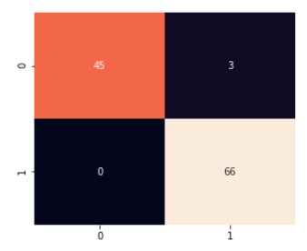
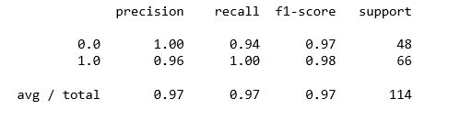
7. CONCLUSION
CONCLUSION
Machine learning techniques (SVM) was able to classify tumors into Malignant/Benign with 97% accuracy.
The technique can rapidly evaluate breast masses and classify them in an automated fashion.
Early breast cancer can dramatically save lives especially in the developing world.
The technique can be further improved by combining Computer vision/ML techniques to directly classify cancer using tissue images.
Notes:
C and Gamma are the parameters for a nonlinear support vector machine (SVM) with a Gaussian radial basis function kernel.
The goal is to find the balance between "not too strict" and "not too loose".
Therefore, often times it is desirable to specifically allow some training points to be misclassified in order to have an "overall better" position of the separating hyperplane.

Slide 21

Image #02
LET’S BUILD A CANCER FREE WORLD

Slide 22

End #02

